Slide 1
Efficiency maine’s recent successes and major opportunities ahead Michael D. Stoddard Executive Director

Slide 2
About Us
Efficiency Maine is an independent trust
Transferred from the Maine PUC to the Trust on 7/1/2010
Directed by a 9-member Board of Trustees representing business and residential energy customers, engineers, energy experts, economists
Funds held in trust for the benefit of the energy consumers who pay in to the funds through the SBC and RGGI
Funds are expended consistent with statute, rules, and 3-Year Strategic Plan to be approved by Trust Board and Maine PUC
Efficiency Maine reduces energy costs in Maine
using market channels, and partnering with customers, to increase the availability and use of energy efficiency and alternative energy resources that cost less than conventional energy supply and to transform energy markets.

Slide 3
Efficiency Maine Trust Results -- Year 1 (FY11 – from July 1, 2010 to June 30, 2011)

Slide 4
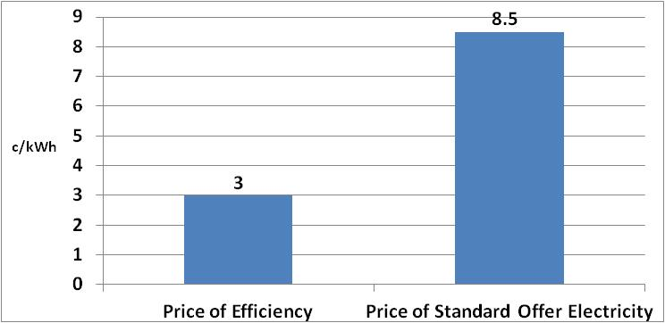
EM’s FY11 Programs Delivered Electricity Savings for 3 c/kWh
Efficiency Maine helps electric customers acquire the cheapest energy in the state

Slide 5
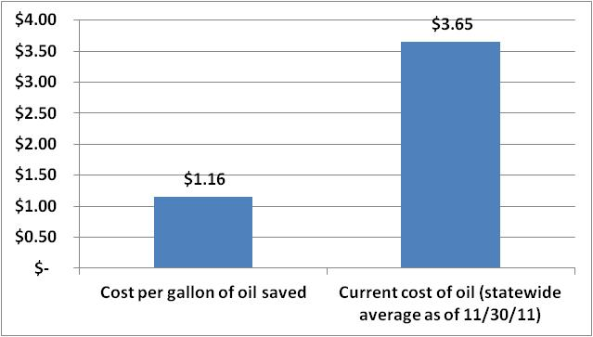
EM’s FY11 Programs Delivered Oil Savings for $1.16/gallon
Efficiency Maine helps residential oil customers acquire the cheapest energy in the state

Slide 6
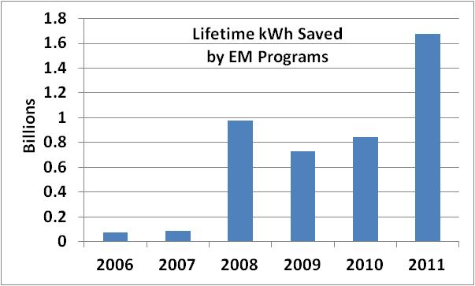
EM Helped Customers in ME Avoid More Wasted Energy than Ever

Slide 7
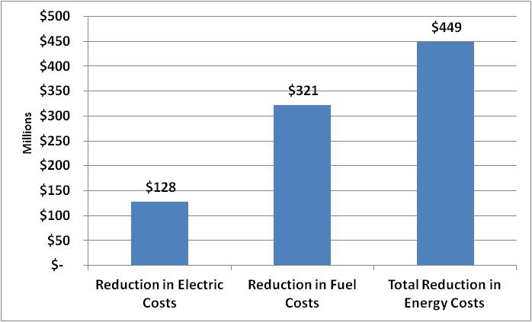
Without EM’s FY11 Programs ... Mainers Would Spend $449M More on Energy
NPV, Lifetime Savings

Slide 8
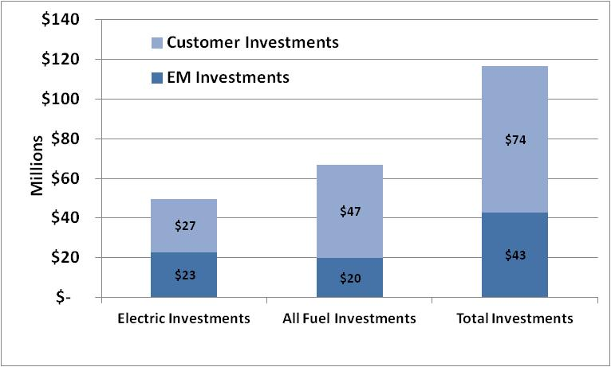
EM Partnered with Customers to Leverage Private Investment in Maine

Slide 9
Investments + Savings = Jobs
Macro-economic study* shows that for every $1 million invested by efficiency programs:
50 FTE jobs for 1 year, if invested in electric saving measures
70 FTE jobs for 1 year, if invested in fuel oil saving measures
EM’s FY11 programs invested:
$22.8 million in electric saving measures
$19.9 million in fuel oil saving measures
Total jobs retained/generated from EM’s FY11 programs
2,538 FTE job-years
* ENE and Economic Development Research Group, Inc., Energy Efficiency: Engine of Economic Growth, Oct. 2009

Slide 10
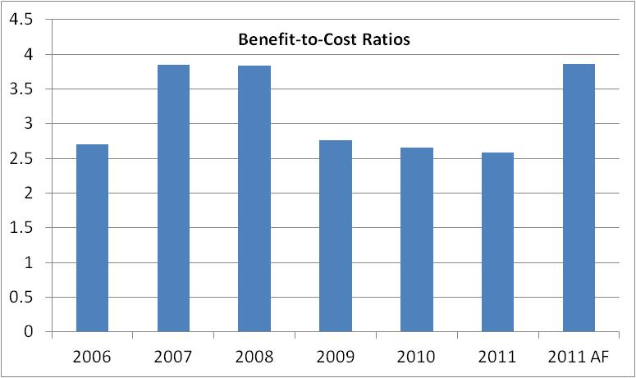
Excellent Benefit-to-Cost Ratio
Exceeded Triennial Plan Metric of 2.3-to-1 Ratio.
B:C Ratios declining due to lower energy costs and slower economy.
AF = All Fuels (includes programs that saved heating fuels).

Slide 11
Efficiency Maine Program Highlights -- Year 1

Slide 12
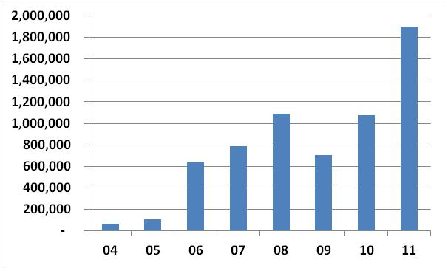
Residential Lighting
# Discounted CFLs Sold by Fiscal Year
$46,745,171 lifetime savings from FY11
1 CFL saves as much as a home’s SBC charge
400 participating big box & hardware stores
Price point, price point, price point

Slide 13
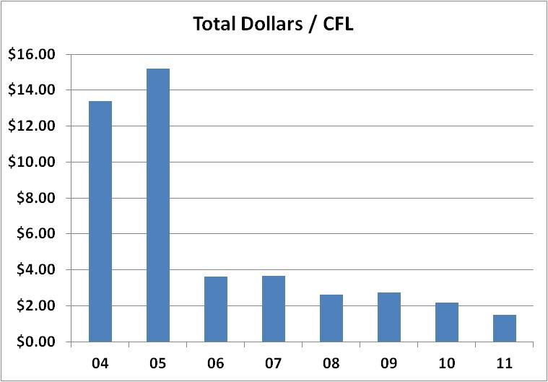
Residential Lighting Illustration of Market Transformation

Slide 14
Home Energy Savings Program
Metric | Results
Audits | 5,053
Completed Energy Upgrades | 3,211
Average Cost/Home | $8,349
Average Energy Savings/Home | 40%
Average Annual Energy Savings/Home | $1,473
Cost/gallon of oil saved | $1.16
Total Annual Energy Saved | 1,290,000 gallons
Total Annual Energy Savings | $4.7 million
Total Investments in Sector | $26.8 million
Customer Satisfaction | 87% “Very Satisfied” w Program

Slide 15
Competitive Bid Program
Very large projects for Maine’s large employers
Funded by RGGI and ARRA
Major oil use and electric reductions
Very low administrative costs, huge savings
Bid Criteria | EM Investment | Leveraged Private Investment | Saved | $ Saved (lifetime)
GHG/$ | $3.4 Million | $15.8 Million | 620,000 tons CO2e | $197.5 Million
kWh/$ | $4.7 Million | $8.4 Million | 423,000,000 kWh | $28.5 Million

Slide 16
Business Incentive Program
More than 400 Qualified Partners Serving as Trade Allies
1,205 Participating Business Customers
586.6 million kWh energy savings (lifetime)
$47.3 million lower electric costs (lifetime)
Trained 175 new Qualified Partners
Added new prescriptive LED lighting incentives
Wall pack fixtures, outside light fixtures, parking garage fixtures, refrigerated case light fixtures, screw-in & pin based LEDs

Slide 17
Business Opportunities Ahead

Slide 18
FY12 Highlights
Business Incentive Program
Fluorescents and LEDs, motors, drives, HVAC, compressed air
$17.9 million program budget
85.5 million kWh saved (year 1 - projected)
$106.3 million saved (lifetime)
Competitive Bid Program
Round 1 - 12 projects, $3.85M EM incentives, $9.85M private investment, 37,200 MWh
Round 2 – RFP due out in January, budget of $2.45M
Residential Programs (Non-Low-Income)
Lighting, Appliances, Refrigerator Recycling
$7.9 million program budget
108 million kWh saved (year 1 – projected)
$65.5 million saved (lifetime)

Slide 19
FY13 – Door Open or Closed? (All Fuels)
Lack of funds for “All Fuel” programs
$10.1 million reduction during FY13 Period (beginning July 1, 2012)
No incentives or technical support for All Fuels support for commercial, industrial, institutional, municipal customers in FY13 (except multi-family apts.)
No rebates for homeowner home weatherization
Decline of projected RGGI revenue
Loss of at least $5.9 million over FY12-13
Uncertain prospects for approval of Long Term Contract with Utilities

Slide 20
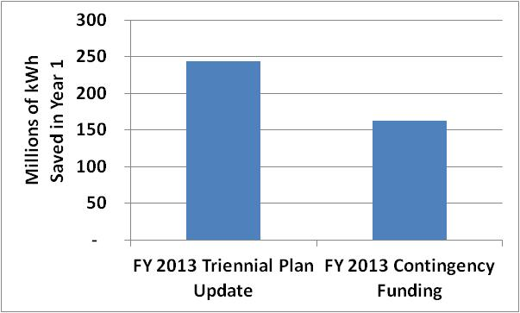
FY13 – Door Open or Closed? (Electric)
If budget gap filled by Long Term Contract
If budget gap not filled by Long Term Contract, customers’ “lifetime” costs increase by $86.4M

Slide 21
Contact:
Michael D. Stoddard
Executive Director
Efficiency Maine Trust
151 Capitol Street
Augusta, Maine 04330
Michael.Stoddard@EfficiencyMaine.com
www.EfficiencyMaine.com
www.SaveLikeAMainer.com

